Slide 1
Beyond MLPs: Convolutional Neural Networks
CS771: Introduction to Machine Learning
Piyush Rai

Slide 2
Plan today
2
Deep neural networks beyond MLPs (Convolutional Neural Networks)
Some other considerations in deep neural network training
Vanishing/exploding gradients
Initialization
Batch normalization

Slide 3



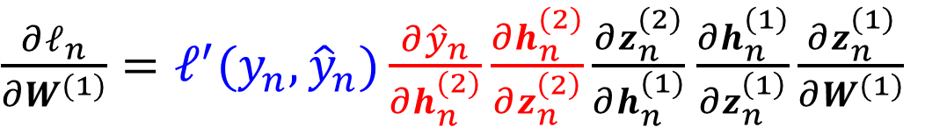

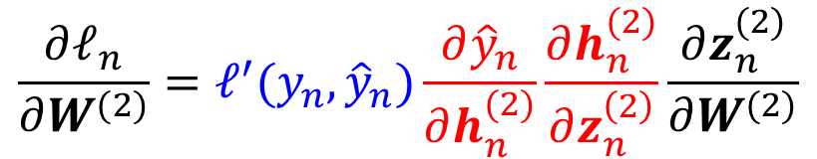

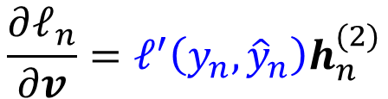


Recap
3
$${\hat{y}}_{n}$$
Multi-layer Perceptrons (MLP)
Backpropagation algorithm to learn the weights
Backprop is based on reuse of previous computations to efficiently compute the gradients required for updating the network weights using (stochastic) GD
$$v$$
$h_{n}^{(2)}=g(z_{n}^{(2)}$)
All these gradients are basically product of Jacobians
$$\frac{∂ℓ_{n}}{∂v}=ℓ^{′}\left(y_{n},{\hat{y}}_{n}\right)h_{n}^{(2)}$$
$$W^{(2)}$$
$h_{n}^{(1)}=g(z_{n}^{(1)}$)
$$\frac{∂ℓ_{n}}{∂W^{(2)}}=ℓ^{′}(y_{n},{\hat{y}}_{n})\frac{∂{\hat{y}}_{n}}{∂h_{n}^{(2)}}\frac{∂h_{n}^{(2)}}{∂z_{n}^{\left(2\right)}}\frac{∂z_{n}^{(2)}}{∂W^{(2)}}$$
$$W^{(1)}$$
$\frac{∂ℓ_{n}}{∂W^{(1)}}=ℓ^{′}(y_{n},{\hat{y}}_{n})\frac{∂{\hat{y}}_{n}}{∂h_{n}^{(2)}}\frac{∂h_{n}^{(2)}}{∂z_{n}^{\left(2\right)}}\frac{∂z_{n}^{(2)}}{∂h_{n}^{(1)}}$ $\frac{∂h_{n}^{(1)}}{∂z_{n}^{\left(1\right)}}\frac{∂z_{n}^{(1)}}{∂W^{(1)}}$
$$x_{n}$$

Slide 4

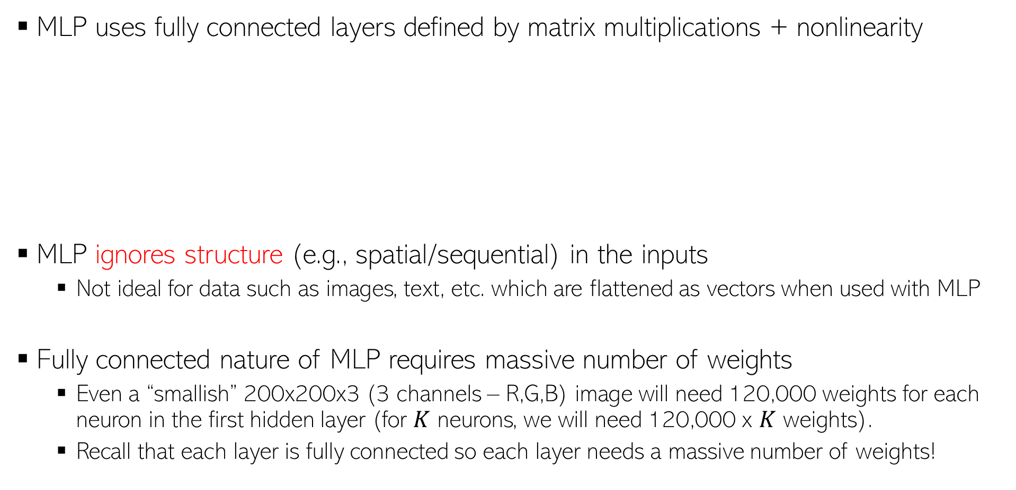





Limitations/Shortcomings of MLP
4
Projection using a “linear layer” + element-wise nonlinearity applied on these linear projections
MLP uses fully connected layers defined by matrix multiplications + nonlinearity
MLP ignores structure (e.g., spatial/sequential) in the inputs
Not ideal for data such as images, text, etc. which are flattened as vectors when used with MLP
Fully connected nature of MLP requires massive number of weights
Even a “smallish” 200x200x3 (3 channels – R,G,B) image will need 120,000 weights for each neuron in the first hidden layer (for $K$ neurons, we will need 120,000 x $K$ weights).
Recall that each layer is fully connected so each layer needs a massive number of weights!
$$h_{n}^{(1)}=g({W^{\left(1\right)}}^{⊤}x_{n})$$
$$h_{n}^{(2)}=g({W^{\left(2\right)}}^{⊤}h_{n}^{\left(1\right)})$$
$$W^{(2)}$$
$$W^{(1)}$$
$$x_{n}$$
$$h_{n}^{(1)}$$

Slide 5
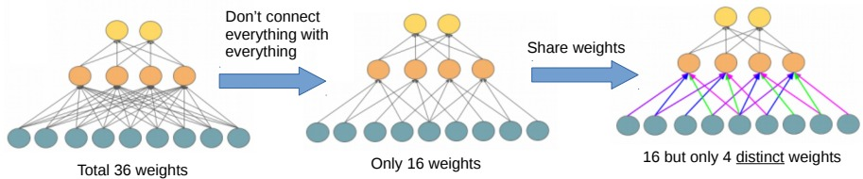
Convolutional Neural Networks (CNN)
5
CNNs use connections between layers that are different from MLPs in two key ways
Change 1: Each hidden layer node is connected only to a local patch in previous layer
Change 2: Same set of weights used for each local patch (purple, blue, green, pink is one set of weights, and this same set of used for all patches)
These changes help in
Substantial reduction on the number of weights to be learned
Learning the local structures within the inputs
Capturing local and global structure in the inputs by repeating the same across layers
Standard MLP

Slide 6
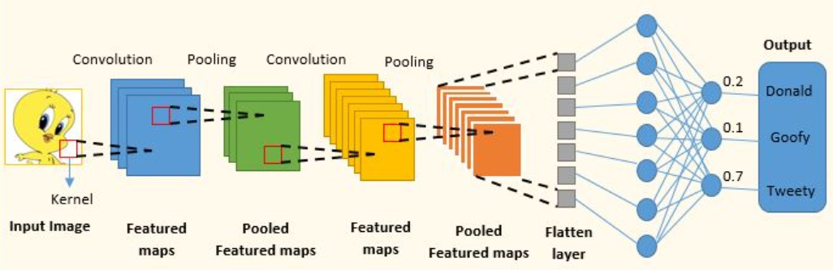
Convolutional Neural Networks (CNN)
6
CNN consists of a sequence of operations to transform an input to output
Convolution (a linear transformation but more “local” than the one in MLP)
Nonlinearity (e.g., sigmoid, ReLU, etc) after the convolution operation
Pooling (aggregates local features into global features and reduce representation size)
Hidden layers
Last (or last few) layer(s) of CNN is (are) usually fully connected just like MLP
Input layer
Figure credit: https://www.analyticsvidhya.com/blog/2022/01/convolutional-neural-network-an-overview/

Slide 7

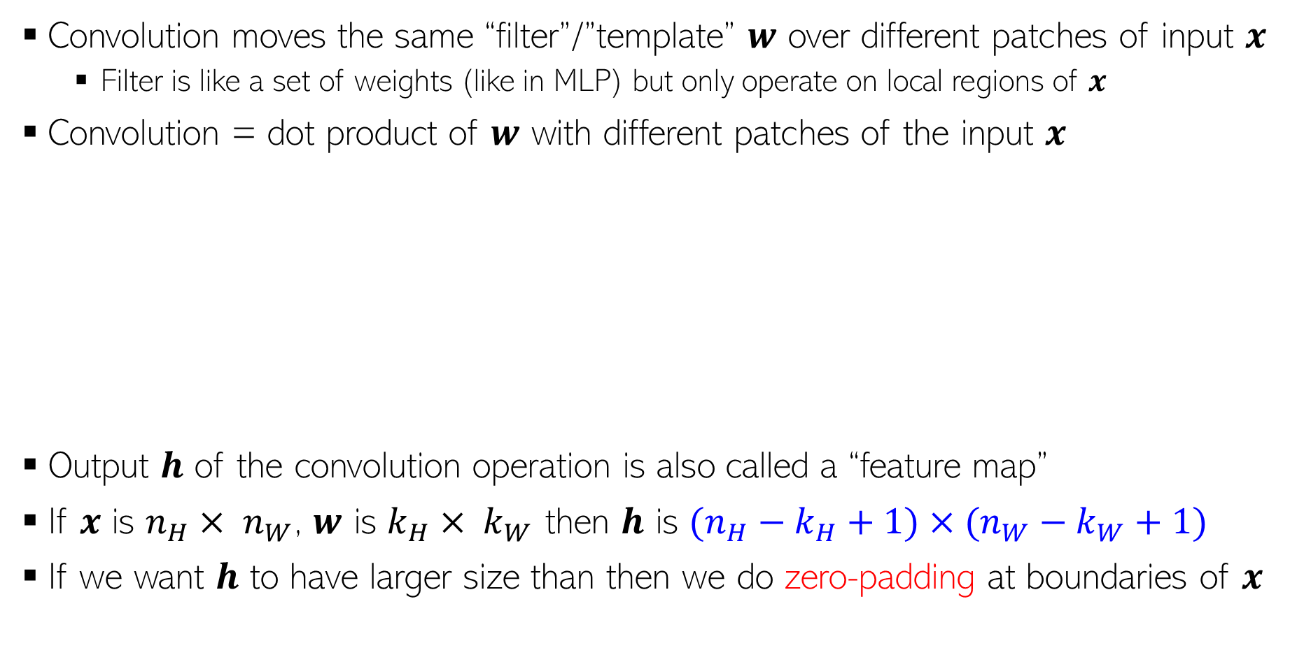





Convolution
Sometimes also called a “kernel”, though not the kernel we have seen in kernel methods ☺
7
Convolution moves the same “filter”/”template” $w$ over different patches of input $x$
Filter is like a set of weights (like in MLP) but only operate on local regions of $x$
Convolution = dot product of $w$ with different patches of the input $x$
Output $h$ of the convolution operation is also called a “feature map”
If $x$ is $n_{H}× n_{W}$, $w$ is $k_{H}× k_{W}$ then $h$ is $(n_{H}−k_{H}+1)×(n_{W}−k_{W}+1)$
If we want $h$ to have larger size than then we do zero-padding at boundaries of $x$
$$x$$
Each entry is result of conv on one patch
$$w$$
$$w$$
$$x$$
$$h$$
Each entry is result of conv on one patch
$$h$$

Slide 8
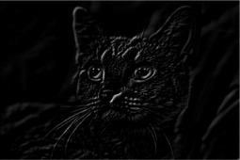


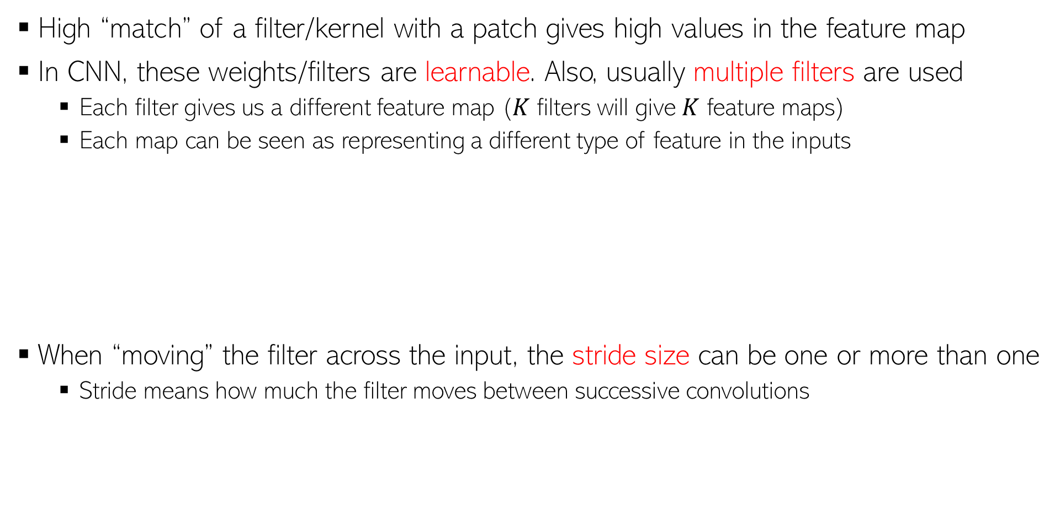




Convolution
8
High “match” of a filter/kernel with a patch gives high values in the feature map
In CNN, these weights/filters are learnable. Also, usually multiple filters are used
Each filter gives us a different feature map ($K$ filters will give $K$ feature maps)
Each map can be seen as representing a different type of feature in the inputs
When “moving” the filter across the input, the stride size can be one or more than one
Stride means how much the filter moves between successive convolutions
“north-west” filter
$$\left[\begin{matrix}−2 & −1 & 0 \\ −1 & 0 & 1 \\ 0 & 1 & 2\end{matrix}\right]$$
“north-east” filter
$$\left[\begin{matrix}0 & −1 & −2 \\ 1 & 0 & −1 \\ 2 & 1 & 0\end{matrix}\right]$$
$$x$$
$$x$$
Stride of 1
Stride of 2

Slide 9
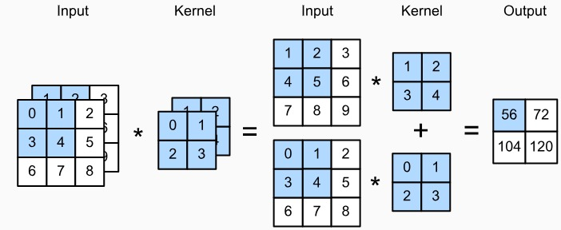
Multiple Input Channels
9
If the input has multiple channels (e.g., images with R,G,B channels), then each filter/kernel also needs to have multiple channels, as shown below (left figure)
We perform per-channel convolution followed by an aggregation (sum across channels)
Note that (right figure above) we typically also have multiple such filters (each with multiple channels) which will give us multiple such feature maps
Input with 3 channels
Output with 2 channels (since we used two filters here)
Figure credit: PML-1 (Murphy, 2022),

Slide 10
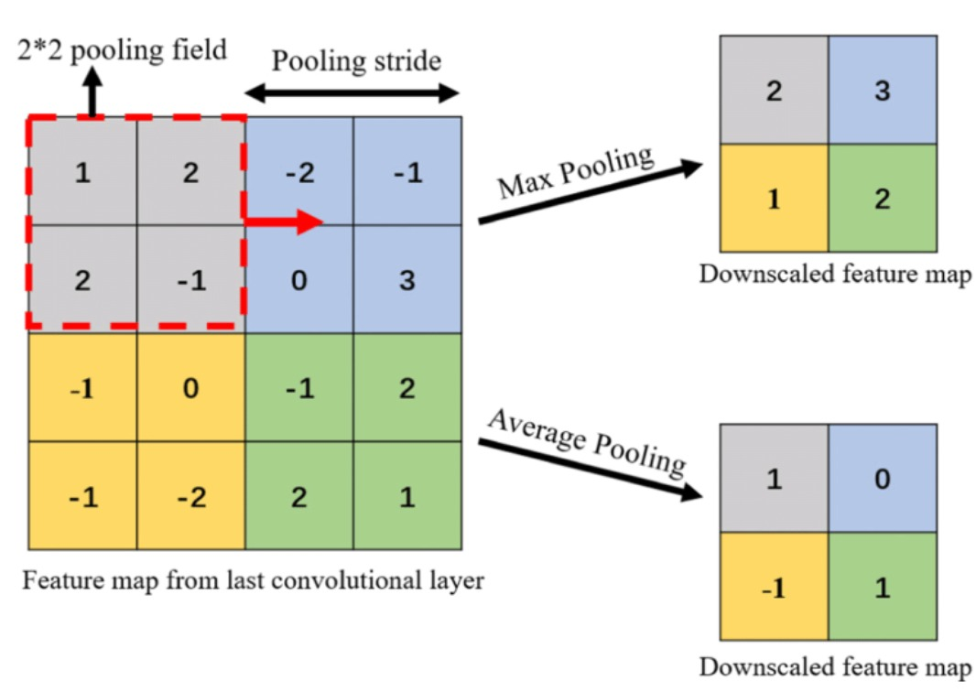
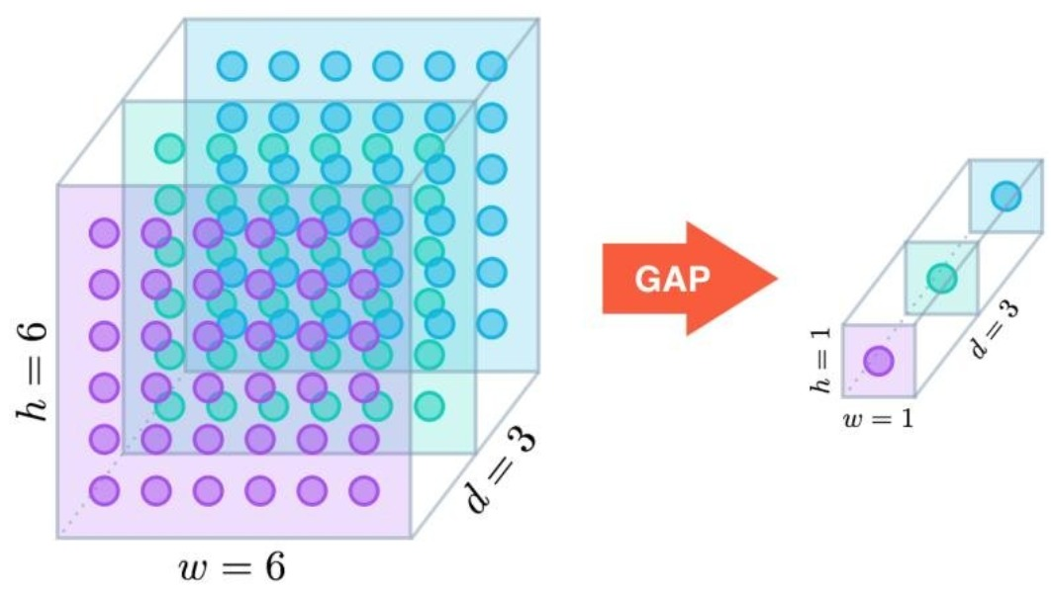
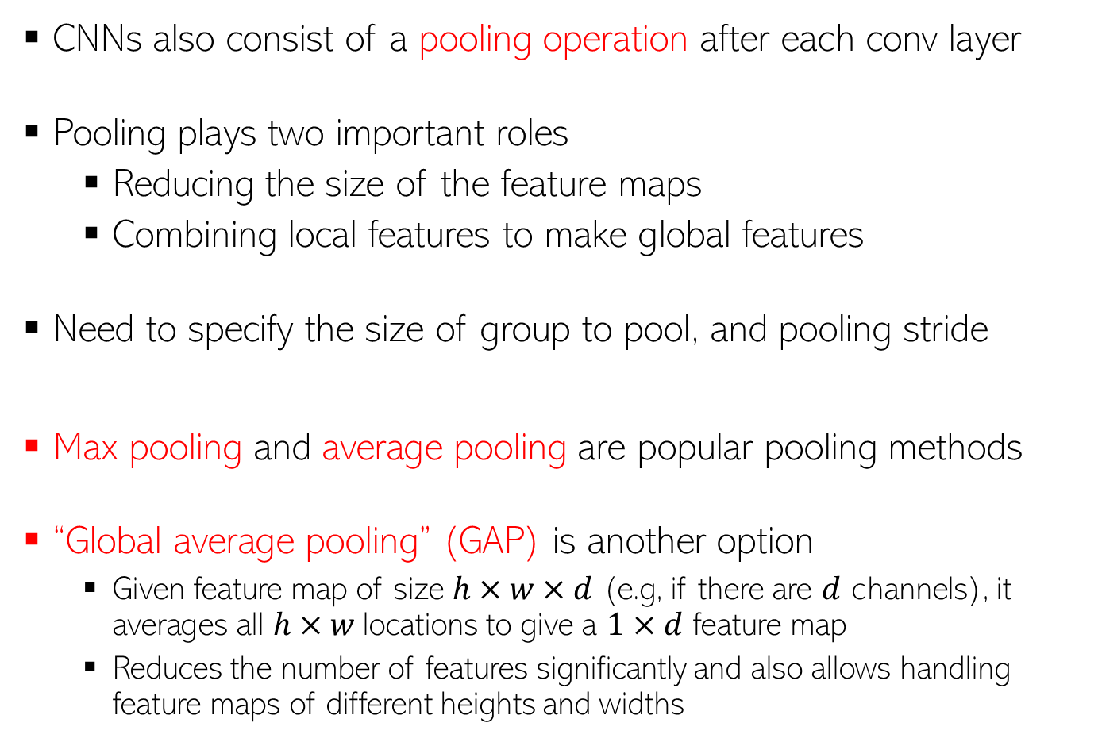
Pooling
10
CNNs also consist of a pooling operation after each conv layer
Pooling plays two important roles
Reducing the size of the feature maps
Combining local features to make global features
Need to specify the size of group to pool, and pooling stride
Max pooling and average pooling are popular pooling methods
“Global average pooling” (GAP) is another option
Given feature map of size $h×w×d$ (e.g, if there are $d$ channels), it averages all $h×w$locations to give a $1×d$ feature map
Reduces the number of features significantly and also allows handling feature maps of different heights and widths
0

Slide 11
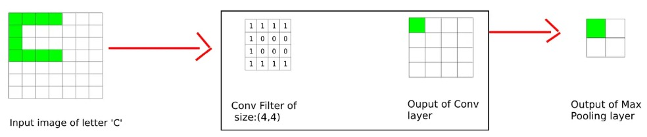
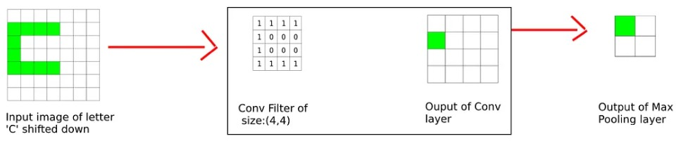
CNNs have Translation Invariance!
11
Even if the object of interest has shifted/translated, CNN don’t face a problem (it will be detected regardless of its location in the image)
The simple example below shows how (max) pooling helps with this
CNNs use a combination of conv + pooling operations in several hidden layers so CNNs remain invariant to even more significant translations
Pic credit: https://divsoni2012.medium.com/translation-invariance-in-convolutional-neural-networks-61d9b6fa03df

Slide 12
CNN: Summary of the overall architecture
12
The overall structure of a CNN looks something like this
Thickness of this box denotes how many filters we used (each filter itself may consist of multiple channels if the input has multiple channels)
Towards the end, we usually flatten the feature map (or use GAP to get a flattened input) and use one or more fully connected layers like in MLP
Pooling only downscales the height and width; The size of the other dimension remains the same as in the previous conv layer
Figure credit: PML-1 (Murphy, 2022),

Slide 13

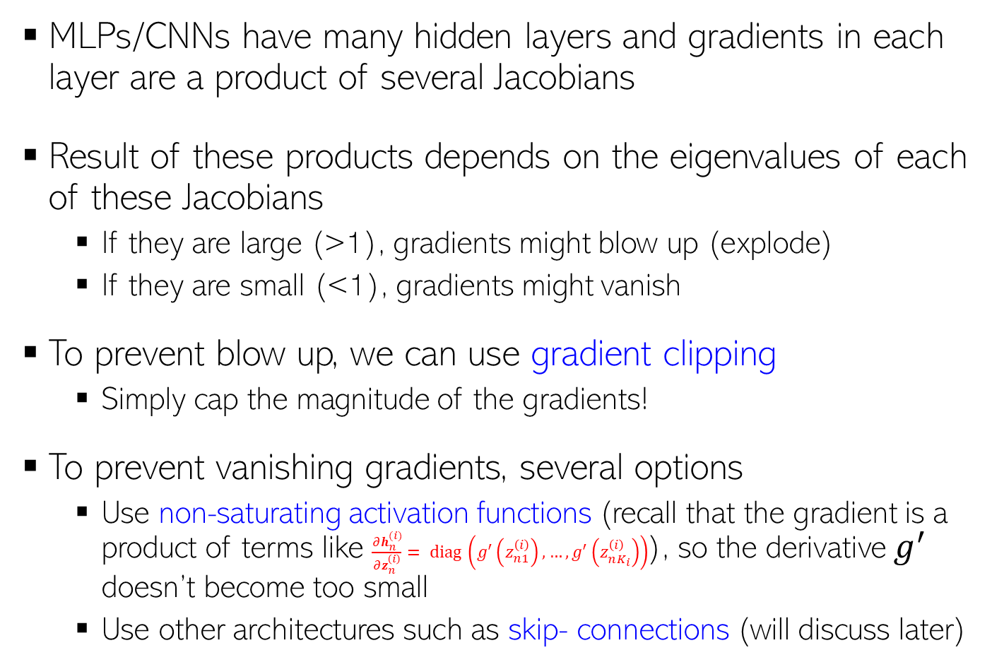






Problem of Exploding/Vanishing Gradients
13
MLPs/CNNs have many hidden layers and gradients in each layer are a product of several Jacobians
Result of these products depends on the eigenvalues of each of these Jacobians
If they are large (>1), gradients might blow up (explode)
If they are small (<1), gradients might vanish
To prevent blow up, we can use gradient clipping
Simply cap the magnitude of the gradients!
To prevent vanishing gradients, several options
Use non-saturating activation functions (recall that the gradient is a product of terms like $\frac{∂h_{n}^{(i)}}{∂z_{n}^{\left(i\right)}}= diag \left(g^{′}\left(z_{n1}^{\left(i\right)}\right),…,g^{′}\left(z_{nK_{i}}^{\left(i\right)}\right)\right)$), so the derivative $g^{′}$ doesn’t become too small
Use other architectures such as skip- connections (will discuss later)
$${\hat{y}}_{n}$$
$$v$$
$h_{n}^{(2)}=g(z_{n}^{(2)}$)
$$W^{(2)}$$
$h_{n}^{(1)}=g(z_{n}^{(1)}$)
$$W^{(1)}$$
$$x_{n}$$

Slide 14
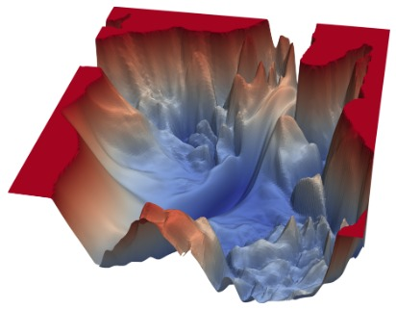
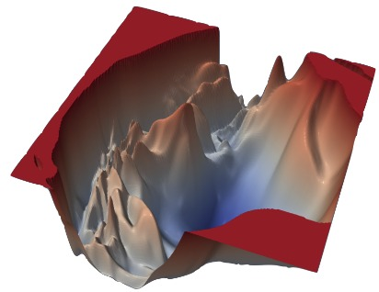
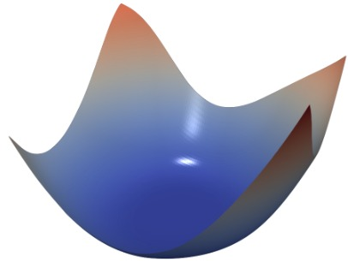
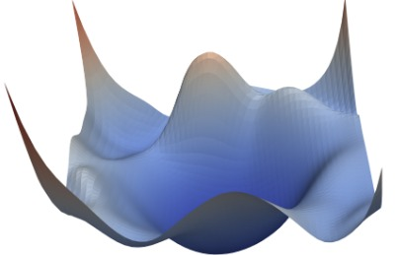

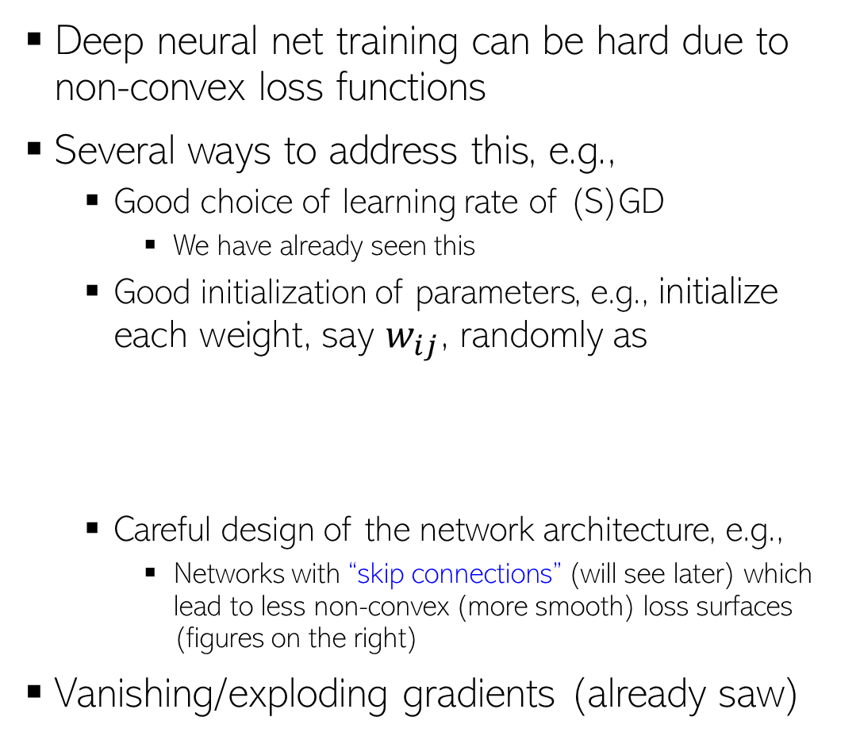


Training of DNNs: Some Important Aspects
14
Deep neural net training can be hard due to non-convex loss functions
Several ways to address this, e.g.,
Good choice of learning rate of (S)GD
We have already seen this
Good initialization of parameters, e.g., initialize each weight, say $w_{ij}$, randomly as
Careful design of the network architecture, e.g.,
Networks with “skip connections” (will see later) which lead to less non-convex (more smooth) loss surfaces (figures on the right)
Vanishing/exploding gradients (already saw)
VGG-56
VGG-110
$$w_{ij}∼𝒩(0,σ^{2})$$
or
$$w_{ij}∼Uniform(−a,a)$$
Resnet-56
Densenet-121
Xavier/Gloret initialization, LeCun init, He init, etc
and set the “spread” of these distribution as inversely proportional to $n_{in}+n_{out}$
Fig credit: https://www.cs.umd.edu/~tomg/projects/landscapes/

Slide 15


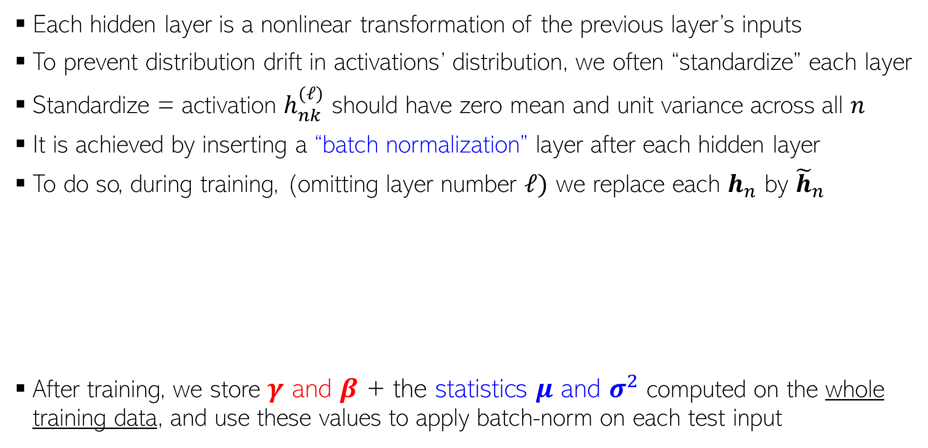
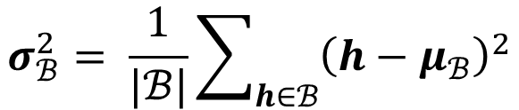
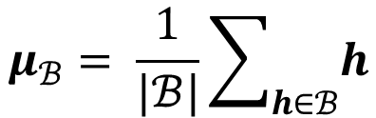

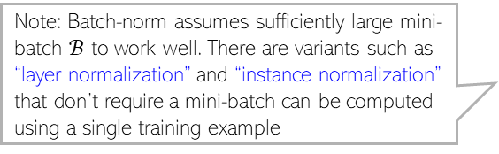

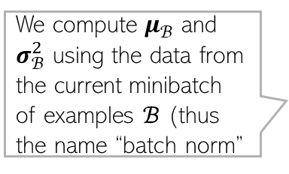
Normalization Layer
Note: Batch-norm assumes sufficiently large mini-batch $ℬ$ to work well. There are variants such as “layer normalization” and “instance normalization” that don’t require a mini-batch can be computed using a single training example
15
Batch normalization is used in MLP, CNN, and various other architectures
Each hidden layer is a nonlinear transformation of the previous layer’s inputs
To prevent distribution drift in activations’ distribution, we often “standardize” each layer
Standardize = activation $h_{nk}^{(ℓ)}$ should have zero mean and unit variance across all $n$
It is achieved by inserting a “batch normalization” layer after each hidden layer
To do so, during training, (omitting layer number $ℓ)$ we replace each $h_{n}$ by ${\tilde{h}}_{n}$
After training, we store $γ$ and $β$ + the statistics $μ$ and $σ^{2}$ computed on the whole training data, and use these values to apply batch-norm on each test input
$γ$ and $β$ are trainable batch-norm parameters
$${\hat{h}}_{n}= \frac{h_{n} −μ_{ℬ}}{\sqrt{σ_{ℬ}^{2}+ε}}$$
$${\tilde{h}}_{n}=γ⊙ {\hat{h}}_{n}+β$$
We compute $μ_{ℬ}$ and $σ_{ℬ}^{2}$ using the data from the current minibatch of examples $ℬ$ (thus the name “batch norm”
$$μ_{ℬ}= \frac{1}{|ℬ|}\sum_{h∈ℬ}{h}$$
$$σ_{ℬ}^{2}= \frac{1}{|ℬ|}\sum_{h∈ℬ}{{\left(h−μ_{ℬ}\right)}^{2}}$$

